Slide 1
Predicting Customer Conversion: Analyzing AnswerAI’ s Trial Participants
Submitted by: Aditi Gupta

Slide 2
Predicting Customer Conversion: Analyzing AnswerAI’ s Trial Participants
Problem Statement
Context
Ask
Key Findings and Recommendations
Appendix

Slide 3
Problem Statement
Leveraging AnswerAI trial program data for 2019 - 2020, pinpoint predictive customer attributes to optimize conversion strategies, empowering product managers for informed decisions and business growth.

Slide 4
Context
AnswerAI is an AI product for businesses to manage user questions on their websites.
When users browse a website, they can click on anything with AnswerAI. A popup window will provide links to suggested articles, FAQs or pictures for their interested items.
Businesses can also have an option to activate chat bots for more interactive answers.
AnswerAI provides a free three(3) month trial for businesses. After the three(3) month trial, businesses can decide if they want to continue to use AnswerAI and become a paid customer.

Slide 5
Ask
AnswerAI Product Managers asked to conduct analysis to understand the performance of the trial program. They are especially interested in the following questions:
How is the AnswerAI trial program doing?
Is there anything they can do to improve the AnswerAI trial program?
Which customers are most likely to convert to a paid customer? How to identify those potential customers who are most likely to convert? Please include your model to explain.

Slide 6
Key Findings

Slide 7
Key Findings: How is the AnswerAI trial program doing?
I measured the performance of the trial through its ability to convert the customer. Here is the summary:
Overall, the trial conversion rate is 31.50%
For ENT accounts, it is 50.87% which is excellent as per SaaS companies' conversion benchmark¹
For SMB accounts, it is 19.33% which needs improvement.
Reference

Slide 8
Key Findings: Is there anything they can do to improve the AnswerAI trial program?
Provide default-activated chatbots in the trials.
Of all the customers that activated chat bot, 71.15% converted to paid customers
83.72% ENT accounts that activated chatbot converted to paid
49.48% SMB accounts that activated chatbot converted to paid
Link Engagement Strategies:
ENT and SMB accounts correlate positively with link engagement metrics.
Improve link engagement by refining content, enhancing user experience, and using data-driven insights.
Encourage interaction with links through incentives, clear CTAs, and smooth navigation.

Slide 9
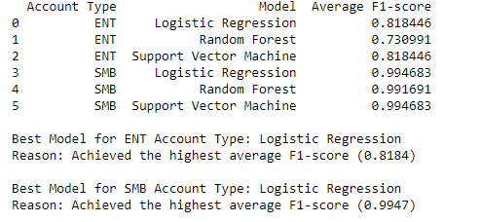
How to identify those potential customers who are most likely to convert? Please include your model to explain.
Goal: Main goal was to identify the potential customers who are most likely to convert to paid.
I evaluated the models for the two account types (ENT and SMB)
After comparing Logistic Regression, Random Forest and Support Vector Machine models, I select the best-model based on highest F1-score.

Slide 10
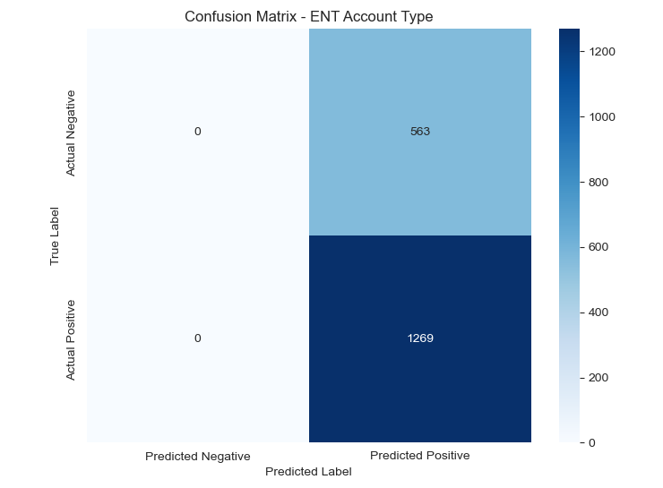
Confusion Matrix for ENT
True Positives: correctly predicted 1269 instances of customers converting to paid
False Negatives : While incorrectly predicting 563 instances as not converting to paid when they did .
There were no True Negatives and False Positives.

Slide 11
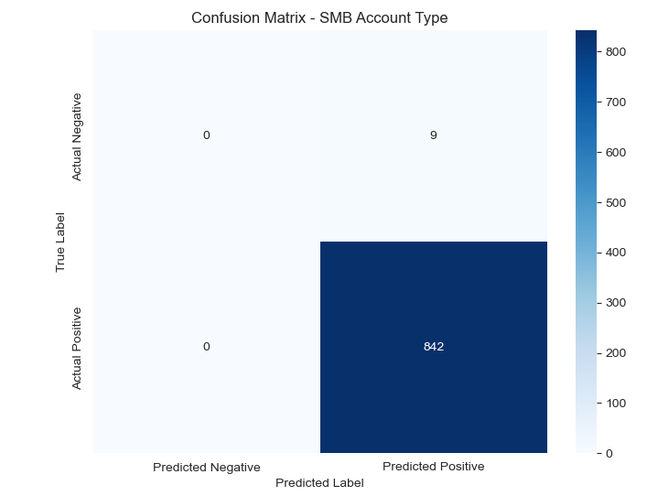
Confusion Matrix for SMB
True Positives: correctly predicted 842 instances of customers converting to paid
False Negatives : While incorrectly predicting 9 instances as not converting to paid when they did .
There were no True Negatives and False Positives.

Slide 12
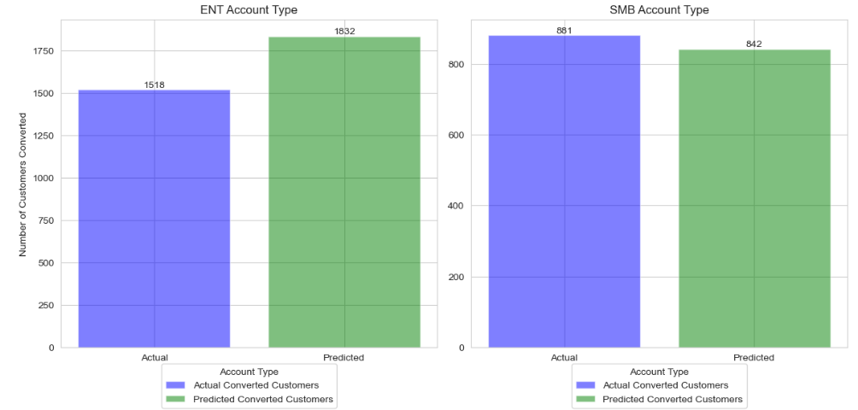
Key Findings: Which customers are most likely to convert to a paid customer?
As per the data model predictions, ENT customers are most likely to convert to the paid customers.

Slide 13
Appendix

Slide 14
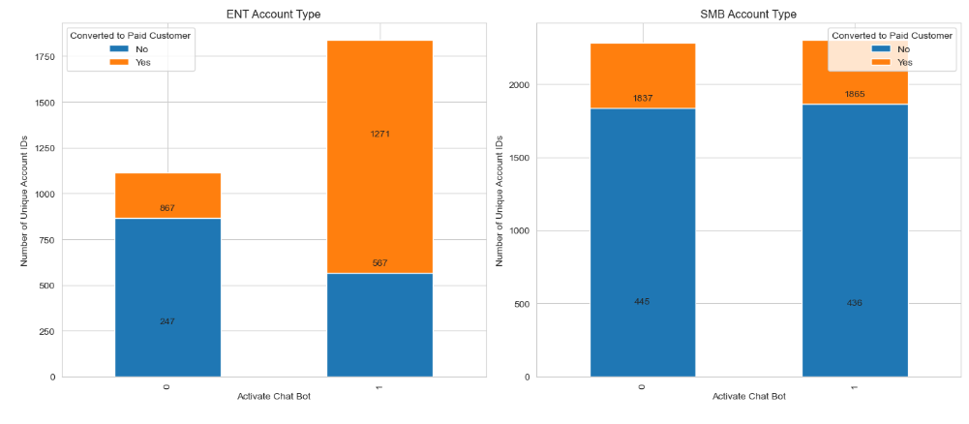
Activation and conversion per account type

Slide 15
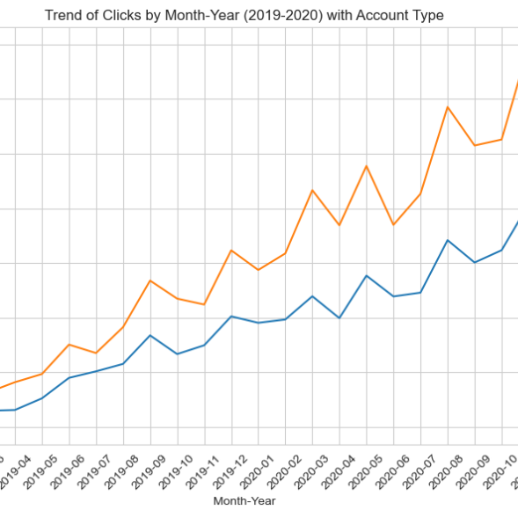
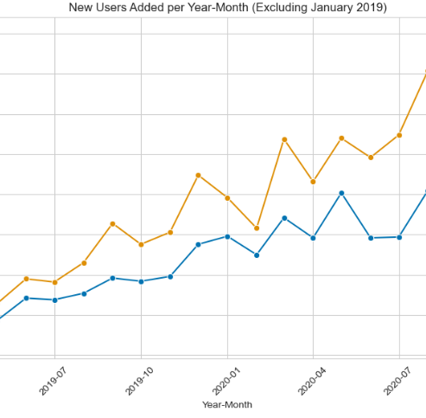
Per month trends of New Accounts and Average clicks

Slide 16
Comparison of metric of interest actual and predicted
 | Actual | Predicted
Conversion Rate | 31.84% | 78.68%
Activation Rate | 54.93% | 84.31%
Average Time to Conversion | 62.25 days | 61.95 days
Conversion and activation rates based on predicted data show potential that these rated can go higher with proper strategy and actions backed by data driven insights.

Slide 17
Definitions
Conversion Rate: The percentage of users who complete a desired action out of the total number of users. Activation Rate: The percentage of users who complete a specific activation event out of the total number of users. Average Time to Conversion: The average duration from initial engagement to completing a desired action. Logistic Regression: A statistical method for predicting binary outcomes based on predictor variables. Random Forest: A machine learning algorithm that constructs multiple decision trees for classification or regression. Support Vector Machine (SVM): A supervised learning algorithm for classification and regression tasks, aiming to find the hyperplane that best separates classes.

Slide 18
Thank you!

